Slide 1
CFD Study of the Development of Vortices on a Ring Wing
Kyle Wright
Embry-Riddle Aeronautical University
Prescott, Arizona

Slide 2
Overview
Background
Wingtip Vortices
Wingtip Devices
Ring Wings
Computational Fluid Dynamics (CFD)
Introduction
Geometry
Mesh
Solver & Boundary Conditions
Results
Conclusion

Slide 3
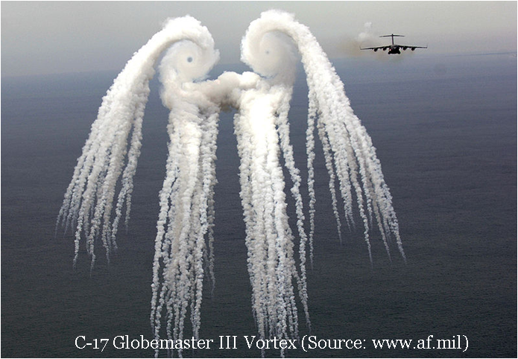
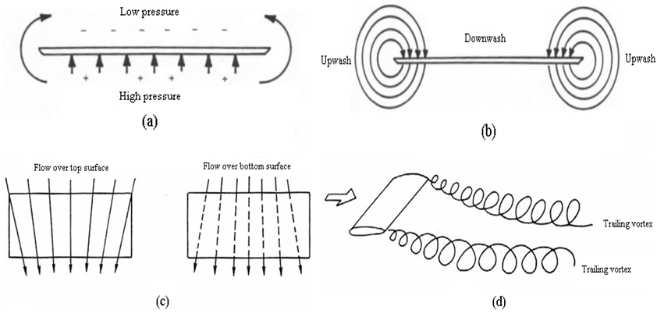
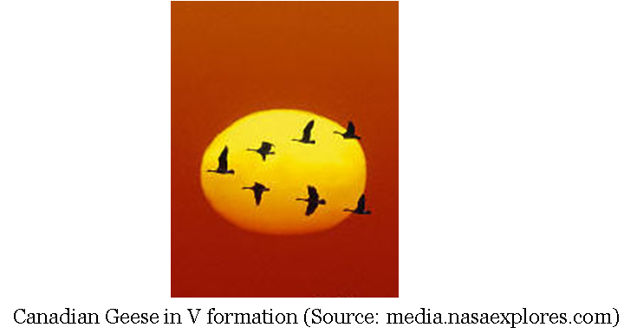
Background: Wing-Tip Vortices

Slide 4
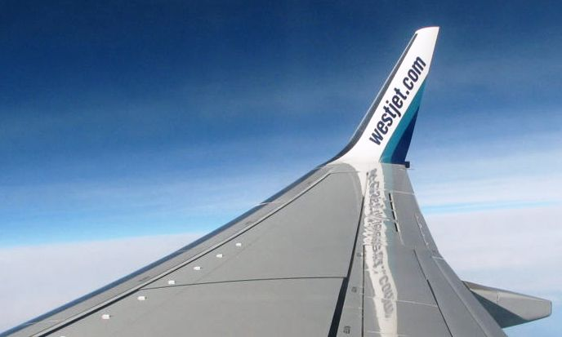
Background: Wingtip Devices
Wingtip Devices: aim to reduce wingtip vortices by decreasing vorticity magnitude and/or moving location away from wing surface to reduce induced drag
Boeing 737 Winglet
(Source: westjet.com)

Slide 5
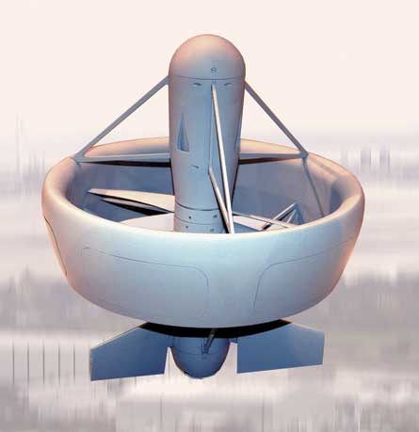
Background: Ring Wings
Ring Wing
Wingtips wrap around to enclose entire wing
Type of closed wing (cylindrical, joined, box wings)
Has no actual wingtips
Decreases induced drag to increase efficiency
Selex Galileo – Asio Ring Wing UAV
(Source: flightglobal.com)

Slide 6
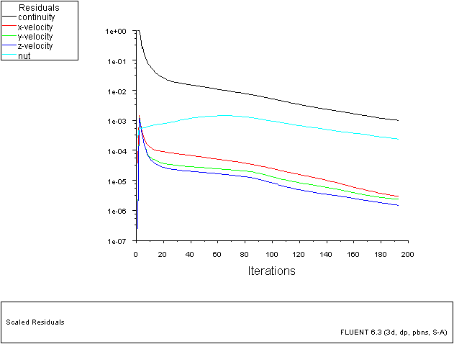
Background: CFD
Computational Fluid Dynamics
Numerical method of solving partial differential equations for viscous fluid flow (Navier-Stokes Equations)
Mesh or discretize flow domain into a structured or unstructured grid to create small finite volumes
Numerically iterate through flow domain matrix with boundary conditions until solution has converged
Aerodynamic Analysis
Experiential Analysis
Computational Fluid Dynamics Analysis
Analytical Analysis

Slide 7
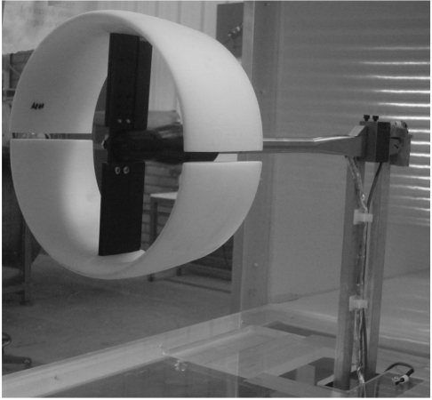
Introduction
Experimental work done by Dr. Lance Traub and students inspired this CFD study, Re = 225,000, V∞ = 40 m/s, Chord = 0.1m≈4 in
Goals
Compare/Match CFD results to experimental work
Show the development of wingtip vortices
Tuft-grid in wake of ring wing
(Source: Fletcher, Herman, “Experimental Investigation of Lift, Drag, and Pitching Moment of Five Annular Airfoils”, NACA TN4117, 1957 )
Ring Wing in 2x2ft blower wind tunnel
(Source: Traub, Lance, “Experimental Investigation of Annular Wing Aerodynamics”,
Journal of Aircraft, Vol. 46, No. 3, 2009, pp. 988-996)

Slide 8
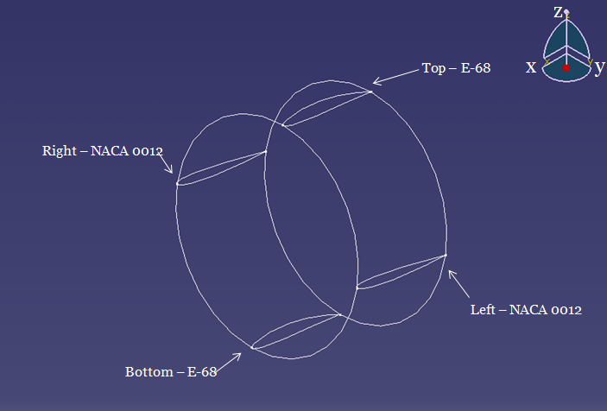
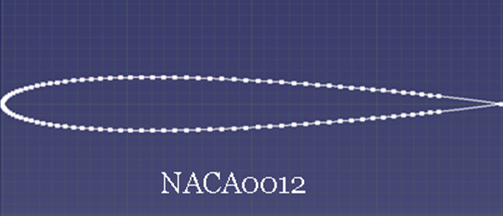
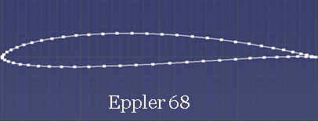
Geometry (CATIA)
Chord Length – 4 in
Diameter – 8 in
Aspect Ratio – 2

Slide 9
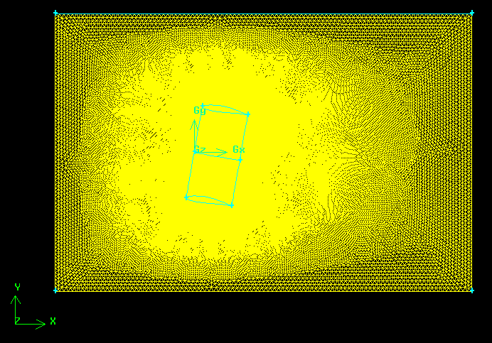
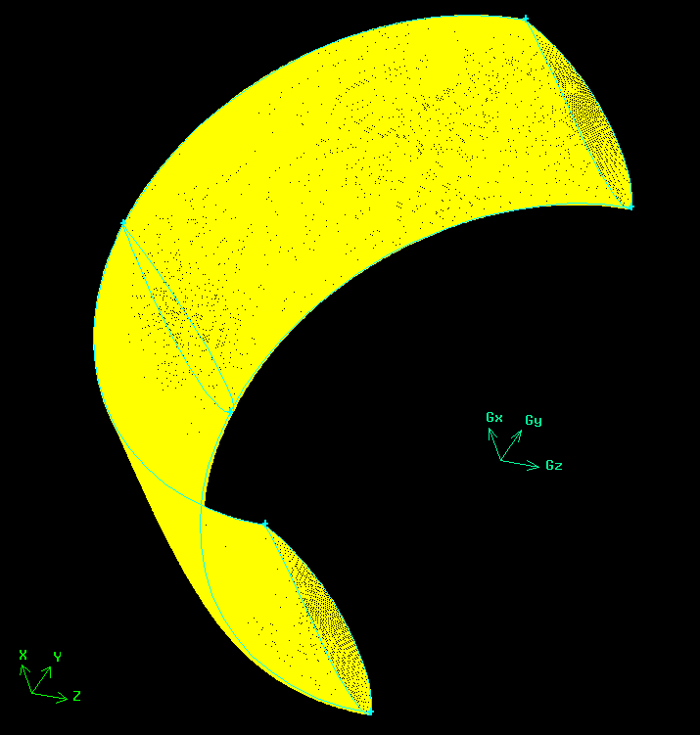
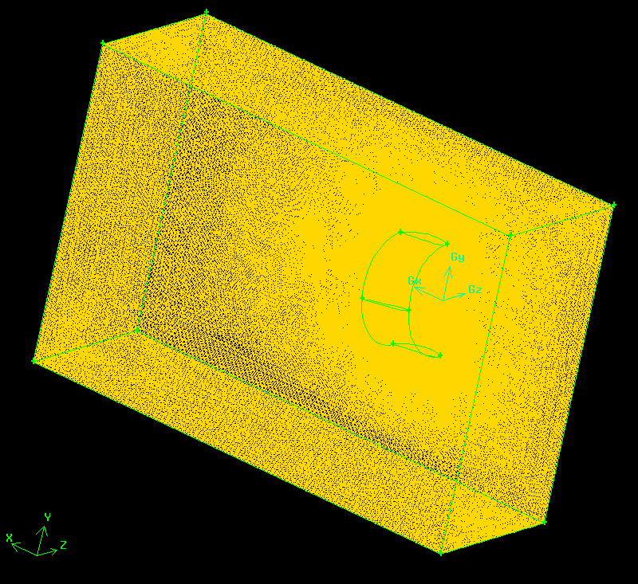
Mesh (GAMBIT)
Average # tetrahedral volumes ≈ 362000

Slide 10
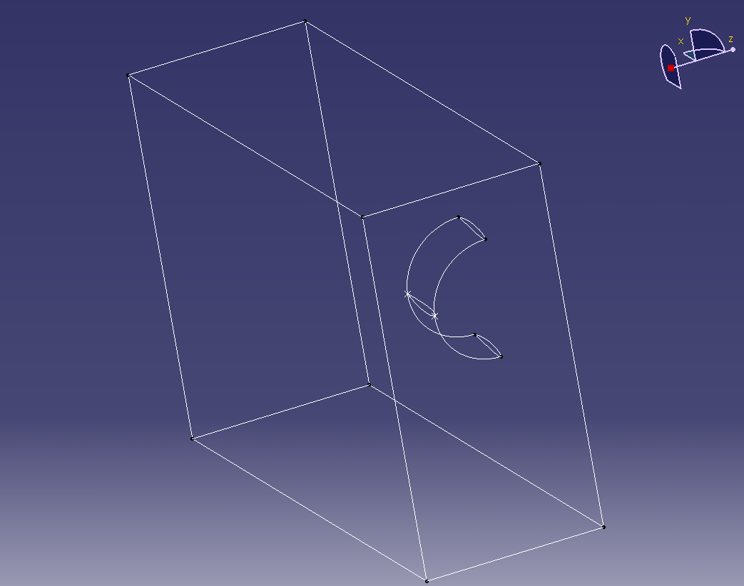
Solver (Fluent) & Boundary Conditions
Pressure based solution from low experimental Reynolds number
Viscous Model: Spalart-Allmaras (single equation)
Density & Viscosity: 1.05 kg/m³ & 1.896e-5 kg/(m s) to match experimental Reynolds number
Inlet: Velocity Inlet at 40 m/s with 0.5% turbulence intensity ratio
Outflow outlet
Symmetry
24 in
Wall – Top,
Bottom, and
Right faces
12 in
Velocity inlet
24 in
12 in

Slide 11
Results: Lift and Drag Coefficient Plots

Slide 12
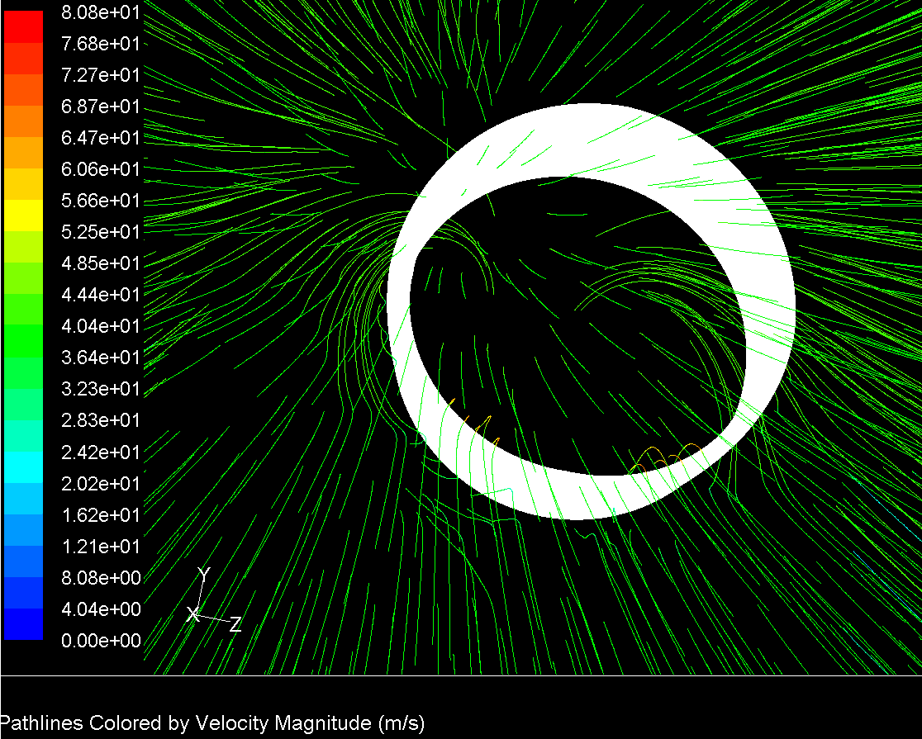
Results: Velocity Pathlines

Slide 13
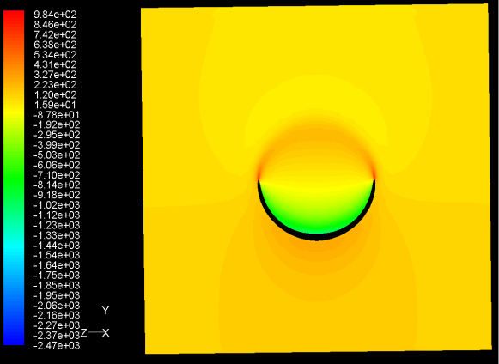
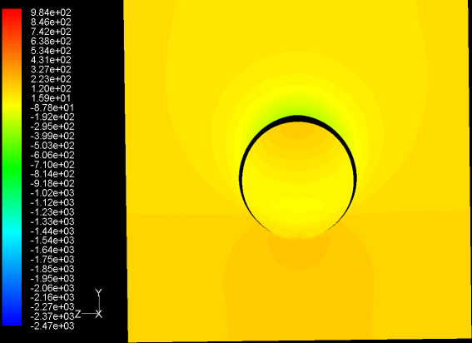
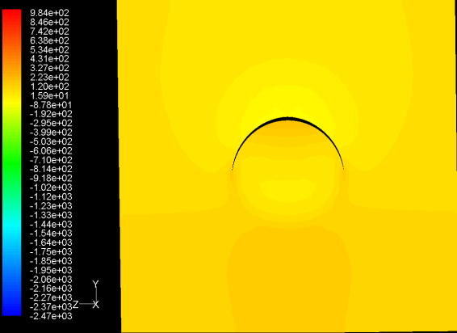
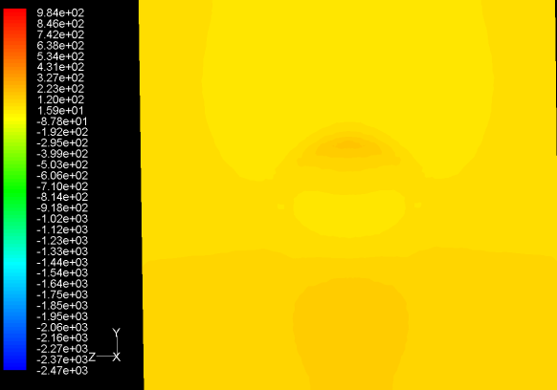
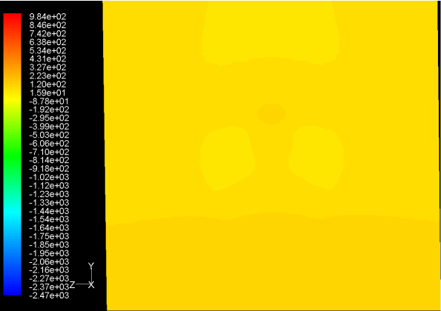
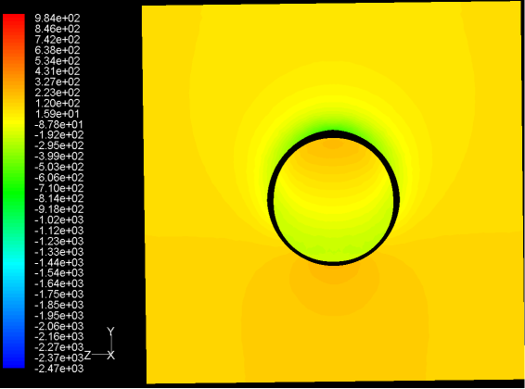
Results: Pressure Contour Plots, AoA = 14°
x = 0 in
x = 2 in
x = 3 in
x = 4 in
x = 5 in
x = 6 in
x = 7 in
x = 8 in
Sweep surface plots for AoA = 14° (Pa)

Slide 14
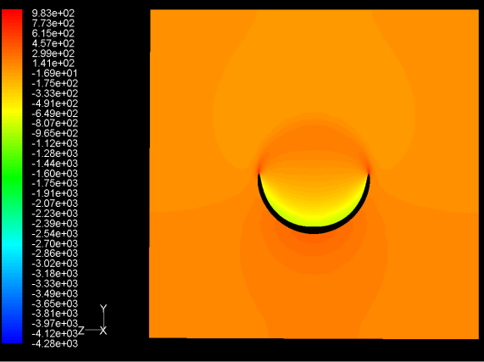
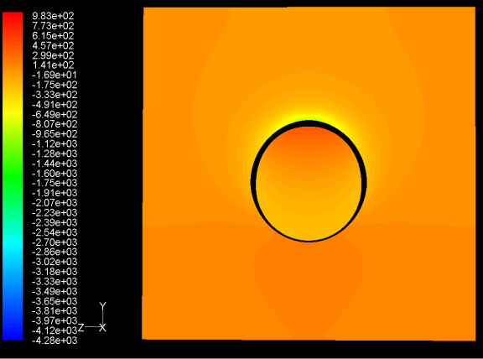
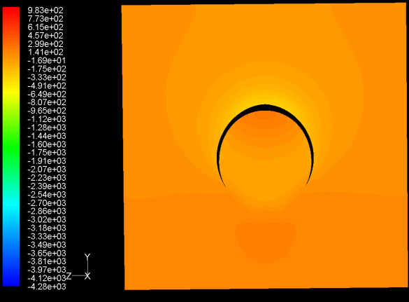
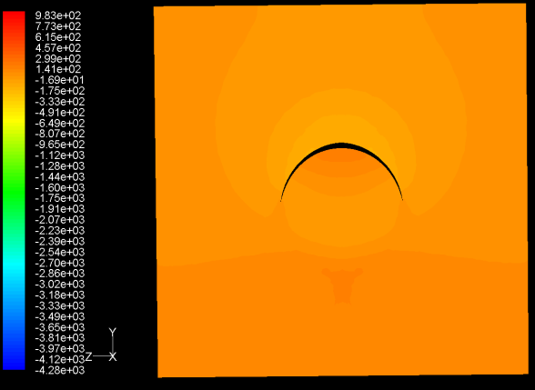
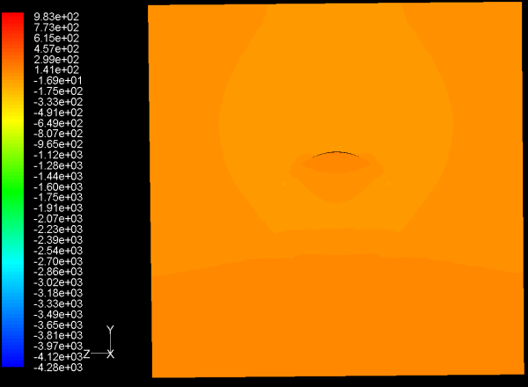
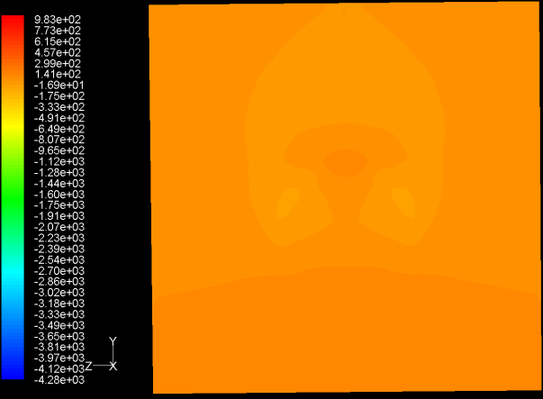
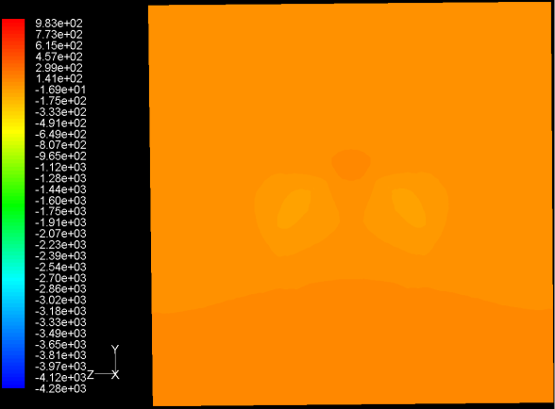
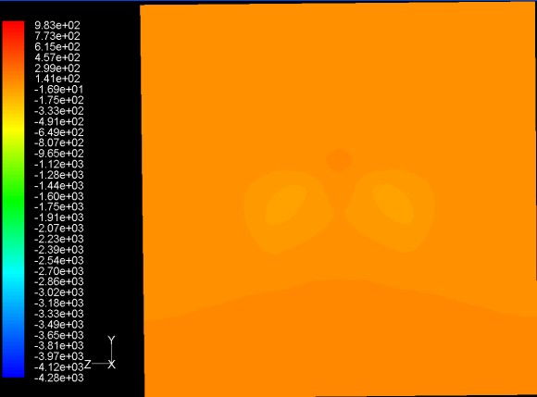
Results: Pressure Contour Plots, AoA = 20°
x = 0 in
x = 2 in
x = 3 in
x = 4 in
x = 5 in
x = 6 in
x = 7 in
x = 8 in
Sweep surface plots for AoA = 20° (Pa)

Slide 15
Conclusion
CFD results followed lift and drag trends of experimental work, especially at lower AoA
CFD results showed the development of two main vortices in the wake region of ring wing

Slide 16
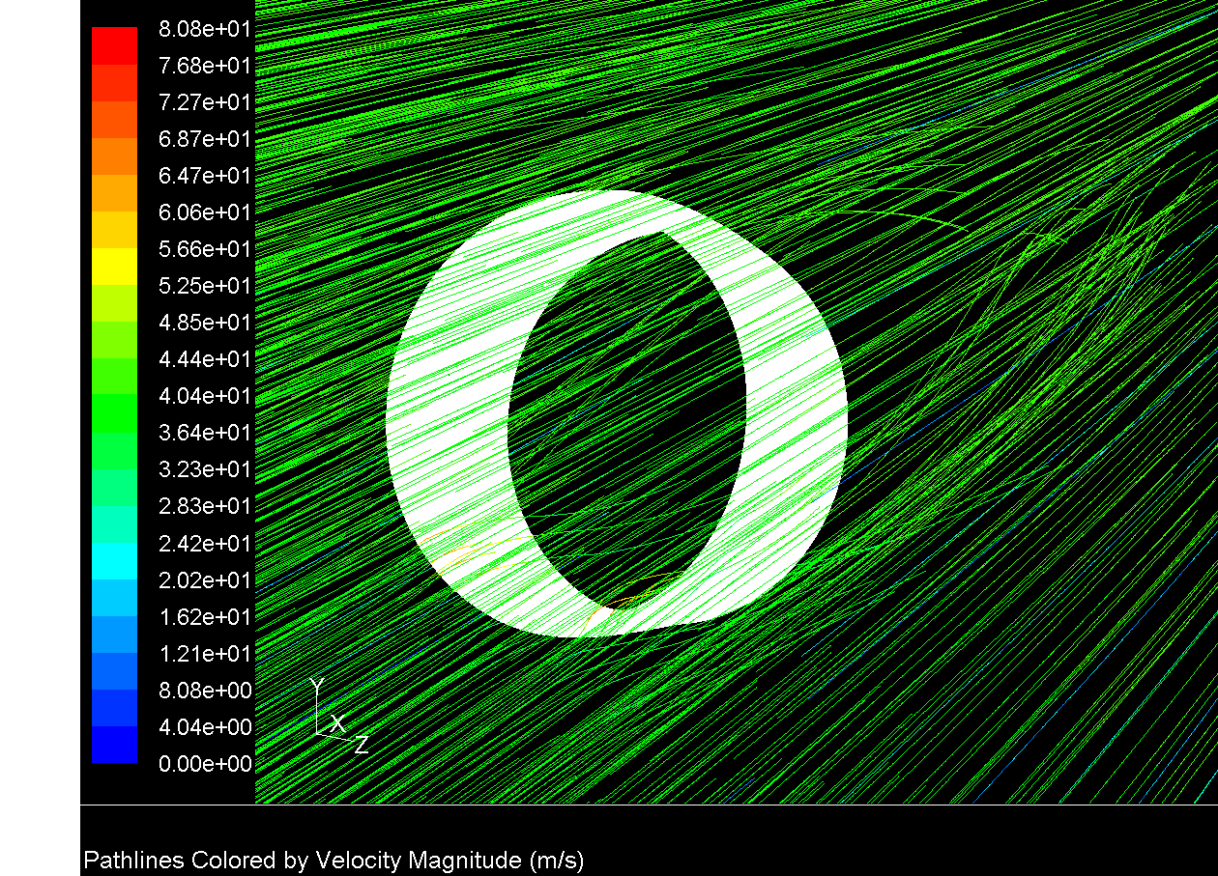
Questions

